Slide 1
Class and Objects ,Access Specifiers,overloading

Slide 2
Object and Class Example: Initialization through reference
class Student{
int id;
String name;
}
class TestStudent3{
public static void main(String args[]){
//Creating objects
Student s1=new Student();
Student s2=new Student();
//Initializing objects
s1.id=101;
s1.name="Sonoo";
s2.id=102;
s2.name="Amit";
//Printing data
System.out.println(s1.id+" "+s1.name);
System.out.println(s2.id+" "+s2.name);
}
}
Output:
101 Sonoo
102 Amit

Slide 3
2) Object and Class Example: Initialization through method
class Student{
int rollno;
String name;
void insertRecord(int r, String n){
rollno=r;
name=n;
}
void displayInformation()
{System.out.println(rollno+" "+name);}
}
class TestStudent4{
public static void main(String args[]){
Student s1=new Student();
Student s2=new Student();
s1.insertRecord(111,"Karan");
s2.insertRecord(222,"Aryan");
s1.displayInformation();
s2.displayInformation();
}
}
Output:
111 Karan
222 Aryan

Slide 4
3. Object and Class Example: Initialization through a constructor
class Employee{
int id;
String name;
float salary;
Employee(int i, String n, float s) {
id=i;
name=n;
salary=s;
}
void display(){System.out.println(id+" "+name+" "+salary);}
}
public class TestEmployee {
public static void main(String[] args) {
Employee e1=new Employee(101,"ajeet",45000);
Employee e2=new Employee(102,"irfan",25000);
Employee e3=new Employee(103,"nakul",55000);
e1.display();
e2.display();
e3.display();
}
}
Output:
101 ajeet 45000.0
102 irfan 25000.0
103 nakul 55000.0

Slide 5
Access Modifiers
The access modifiers specifies accessibility (scope) of a data member, method, constructor or class.
There are two types of modifiers in java: access modifiers and non-access modifiers.
There are 4 types of java access modifiers:
private
default
protected
public
There are many non-access modifiers such as static, abstract, synchronized, native, volatile, transient etc. Here, we will learn access modifiers.

Slide 6
Modifier | Description
Private | Declarations are visible within the class only
Default | Declarations are visible only within the package (package private)
Protected | Declarations are visible within the package or and all sub classes
Public | Declarations are visible everywhere

Slide 7
private access modifier
class A{
private int data=40;
private voidmsg()
{System.out.println("Hello java");}
}
public class Simple{
public static void main(String args[]){
A obj=new A();
System.out.println(obj.data);//Compile Time Error
obj.msg();//Compile Time Error
}
}
Role of Private Constructor
class A{
private A(){}//private constructor
void msg()
{System.out.println("Hello java");}
}
public class Simple{
public static void main(String args[]){
A obj=new A();//Compile Time Error
}
}

Slide 8
//save by B.java
package mypack;
import pack.*;
class B{
public static void main(String args[]){
A obj = new A();//Compile Time Error
obj.msg();//Compile Time Error
}
}
default access modifier
//save by A.java
package pack;
class A{
void msg(){System.out.println("Hello");}
}

Slide 9
protected access modifier
//save by A.java
package pack;
public class A{
protected void msg()
{
System.out.println("Hello");}
}
//save by B.java
package mypack;
import pack.*;
class B extends A{
public static void main(String args[]){
B obj = new B();
obj.msg();
}
}
Output:Hello

Slide 10
public access modifier
//save by A.java
package pack;
public class A{
public void msg(){System.out.println("Hello");
}
}
//save by B.java
package mypack;
import pack.*;
class B{
public static void main(String args[]){
A obj = new A();
obj.msg();
}
}
Output:Hello

Slide 11
Access Modifier | within class | within package | outside package by subclass only | outside package
Private | Y | N | N | N
Default | Y | Y | N | N
Protected | Y | Y | Y | N
Public | Y | Y | Y | Y

Slide 12
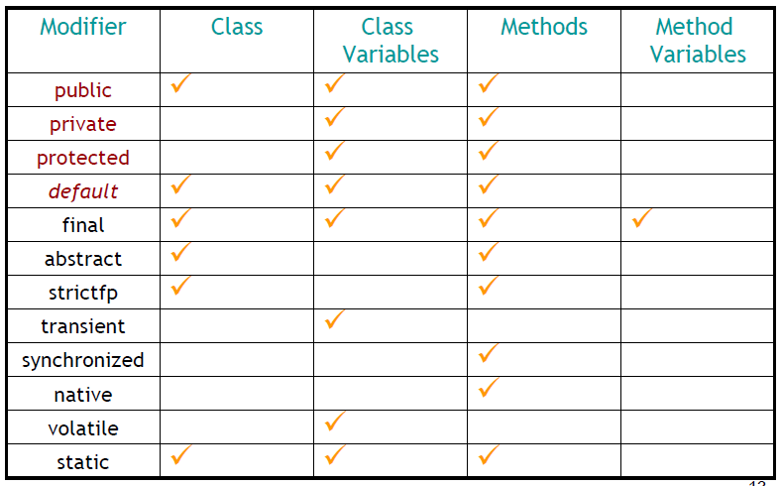

Slide 13
Method Overloading
Many methods have same name but different arguments
Different ways to overload the method
By changing the no. of arguments
By changing the datatype
Why method overloading is not possible by changing the return type
Can we overload the main method
method overloading with Type Promotion

Slide 14
Different ways to overload the method
By changing the no. of arguments | By changing the datatype
class Adder{ static int add(int a,int b){return a+b;} static int add(int a,int b,int c){return a+b+c;} } class TestOverloading1{ public static void main(String[] args){ System.out.println(Adder.add(11,11)); System.out.println(Adder.add(11,11,11)); }} | class Adder{ static int add(int a, int b){return a+b;} static double add(double a, double b){return a+b;} } class TestOverloading2{ public static void main(String[] args){ System.out.println(Adder.add(11,11)); System.out.println(Adder.add(12.3,12.6)); }}

Slide 15
Why method overloading is not possible by changing the return type?
because of ambiguity, method overloading is not possible by changing the return type of the method.
class Adder{
static int add(int a,int b){return a+b;}
static double add(int a,int b){return a+b;}
}
class TestOverloading3{
public static void main(String[] args){
System.out.println(Adder.add(11,11));//ambiguity
}}
Output:
Compile Time Error: method add(int,int) is already defined in class Adder

Slide 16
Can we overload java main() method?
Yes, by method overloading. You can have any number of main methods in a class by method overloading. But JVM calls main() method which receives string array as arguments only.
class TestOverloading4{
public static void main(String[] args){System.out.println("main with String[]");}
public static void main(String args){System.out.println("main with String");}
public static void main(){System.out.println("main without args");}
}

